Slide 1
Modeling Second Order Systems in Simulink
SOEN385
Control Systems and Applications

Slide 2
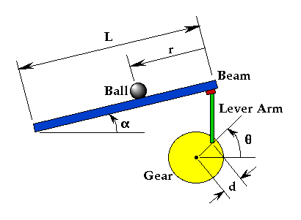
Problem Setup
A ball is placed on a beam, where it is allowed to roll with 1 degree of freedom along the length of the beam.
A lever arm is attached to the beam at one end and a servo gear at the other.

Slide 3
Problem Setup
As the servo gear turns by an angle theta, the lever changes the angle of the beam by alpha.
When the angle is changed from the horizontal position, gravity causes the ball to roll along the beam.
A controller is desirable for this system so that the ball's position can be manipulated.

Slide 4
Problem Setup
We assume that the ball rolls without slipping and friction between the beam and ball is negligible.
The constants and variables for this example are defined as follows:
M mass of the ball 0.11 kg
R radius of the ball 0.015 m
D lever arm offset 0.03 m
g gravitational acceleration 9.8 m/s^2
L length of the beam 1.0 m
J ball's moment of inertia 9.99e-6 kgm^2
r ball position coordinate
α beam angle coordinate
θ servo gear angle

Slide 5
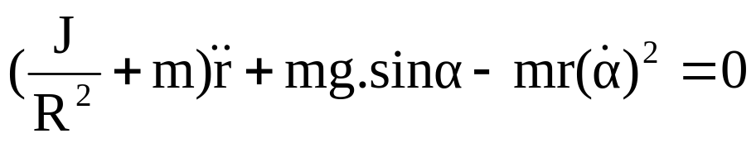
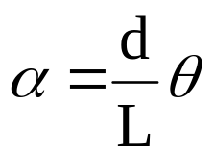
System Equations
The Lagrangian equation of motion for the ball is given by:
The beam angle (alpha) can be expressed in terms of the angle of the gear (theta):

Slide 6
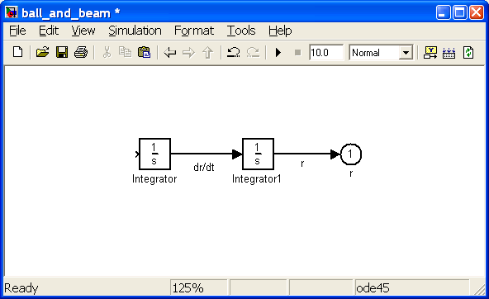
Building the Model in Simulink
We model the nonlinear equation of motion directly.
Use the Nonlinear Function Block to express this function.
First make the derivatives of the output r.

Slide 7

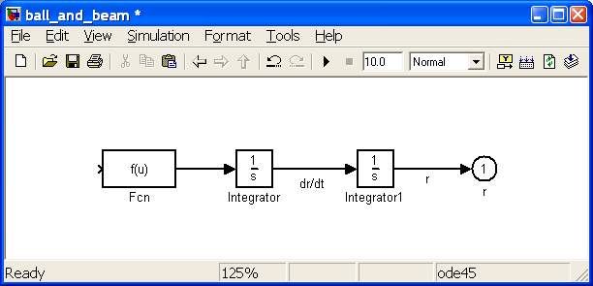
Building the Model in Simulink
Now, insert the function which takes the vector [r dr/dt α dα/dt] and returns

Slide 8
Building the Model in Simulink
Edit the Fcn block by double clicking it, and change it's function to:
(-1/(J/(R^2)+m))*(m*g*sin(u[3])-m*u[1]*(u[4])^2)
This function block takes an input vector u, where each component is referred to as u[1], u[2], etc. In our case, u[1]=r, u[2]=dr/dt, u[3]=α, and u[4]=dα/dt.
Change the label of the Fcn block to "Ball-Beam Lagrangian Model"

Slide 9
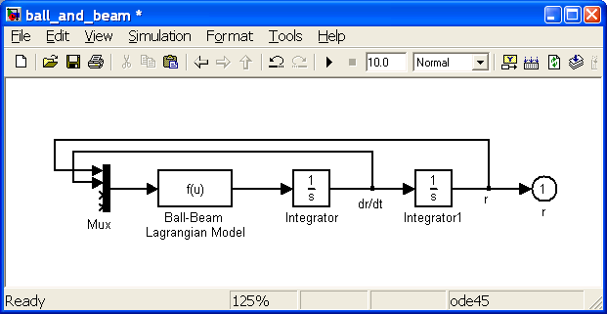
Building the Model in Simulink
Construct the function input vector u by feeding back the state signals from the integrators and forming a vector from them with a Mux block.

Slide 10
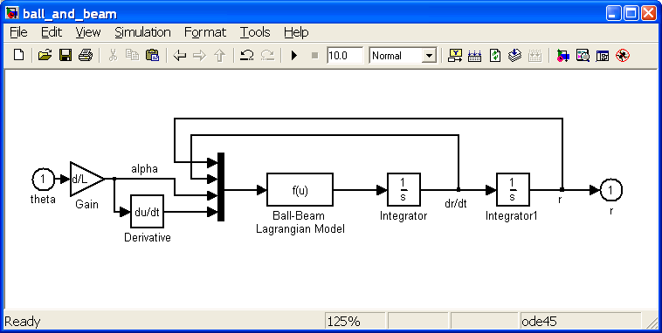
Building the Model in Simulink
Now we construct the signals α and dα/dt from the input θ.

Slide 11
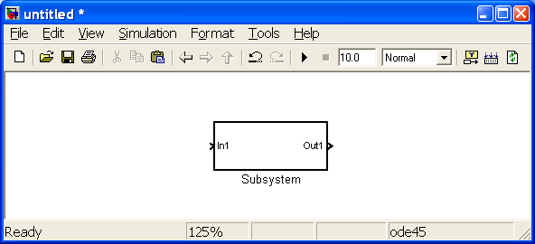
Simulate the Model
Create a new model window.
Insert a Subsystem block
Open the Subsystem block by double clicking on it.
Copy and paste the previous model into Subsystem window.
Label the Subsystem block “Ball and Beam Model”.

Slide 12
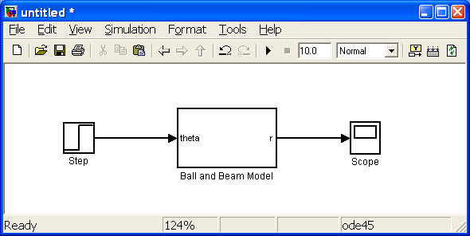
Simulate the Model
Insert a Step and a Scope block and connect them to the input and output of the Ball and Beam Model.

Slide 13
Simulate the Model
Before obtaining the step response, we must set the physical parameters.
Enter the following commands in the command prompt:
m = 0.111;
R = 0.015;
g = -9.8;
L = 1.0;
d = 0.03;
J = 9.99e-6;

Slide 14
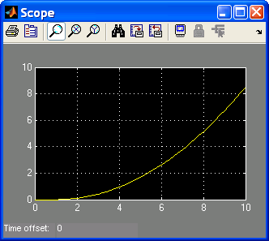
Simulate the Model
Step Response
So the system is unstable in open-loop causing the ball to roll off the end of the beam.

Slide 15
Communication with MATLAB
The Simulink model can be extracted into an equivalent state-space or transfer function model in MATLAB.
  This is done through the use of In and Out Connection blocks and the MATLAB function linmod.
  >> [A,B,C,D] = linmod('ball_and_beam');
  >> [num,den] = ss2tf(A,B,C,D)
Some other useful functions:
  get_param Read the parameter value in a Simulink Model
  set_param Changes the parameter value in a Simulink Model
  sim Runs a Simulink simulation from Matlab command line
Useful Simulink blocks:
  To Workspace, To File, From Workspace, From File

Slide 16
References
Control Tutorials for MATLAB and Simulink
http://www.library.cmu.edu/ctms/ctms/index.htm

